Slide 1


Slide 2

Operating Systems - Windows

Slide 3
Overview
By the end of this module you should have a basic understanding of:
Windows 10
hardware requirements
installation
Activation
partitions and file systems.
file system attributes and permissions.
folder structure and navigation.
working with files and folders at the Command Prompt.

Slide 4
Hardware Requirements
Before installing a copy of Microsoft Windows it is important to verify that the target platform at very least meets the stated hardware requirements for the given operating system.
For example, for Windows 7 & 10:
Component | Windows 7 | Windows 10
CPU | 1 GHz | 1 GHz
RAM | 1 GB | 1 GB (2 for 64bit)
Hard Disk | 16 GB | 20 GB (24 GB for 64 bit)
Video Card | Dirct X 9 with 128 MB of RAM
Optical Drive | DVD-R/W | Optional
Network Interface | Compatible Device

Slide 5
Hardware Requirements
Hardware requirements are always listed as the minimum recommended requirements.
For Windows 10:
Windows 10 Hardware Requirements
Take a moment to read through these pages.

Slide 6
Hardware Requirements
Another issue you need to consider is hardware compatibility since not all hardware works with every operating system.
Microsoft should have a HCL (Hardware Compatibility List) for current versions of their operating system, including server and IoT versions. Search Microsoft for this, as it often changes.
The HCL tells you if a specific piece of hardware is known to work with specific Windows systems (client and server)

Slide 7
Hardware Requirements
Devices that are not on the list may not have “drivers” available on the standard installation media or as a download from Microsoft.
If this is the case, check the manufacturers website.
If no driver is available then Windows will not recognize the hardware and it will not be enabled.

Slide 8
Upgrading to Windows10
Microsoft has made upgrading from earlier versions of Windows to Windows 10 quite easy
Up until July 29th 2016, it was free
Upgrade works from Windows 7, 8, and 8.1 without issue.

Slide 9
Common Installation Problems
Media errors caused by damaged or defective installation media
Insufficient disk space, memory, or processing power.
Hardware not on the HCL or that has no driver.
Incorrect product key
Networking failure

Slide 10
Installation
Windows 10 uses a three stage installation process:
Gather Information
Installation language
Installation type
New install or upgrade
Windows 10 – if new install, you will be prompted for your Windows product key
Keyboard type or input method
Time and Location
User acceptance of license agreement
Disk partitions

Slide 11
Installation
Install Windows
Copy all required files to a physical storage device
This part of the process takes the longest
Configure Windows
Username and computer name
Windows 10 – you may sign in with credentials from Microsoft, such as a hotmail.com account
Security settings
Product key

Slide 12
Windows 10 Activation
With Windows 10, the product key for Windows could be found in the BIOS or UEFI on certain motherboards, often from off-the-shelf vendors such as HP and Lenovo.
If you have a laptop or desktop with a Windows sticker on it, but no product key sticker, it is likely that the product key is stored in the UEFI
When installing Windows 10 on these systems, the installer will pull the product key from the UEFI (or in some cases, the BIOS)

Slide 13
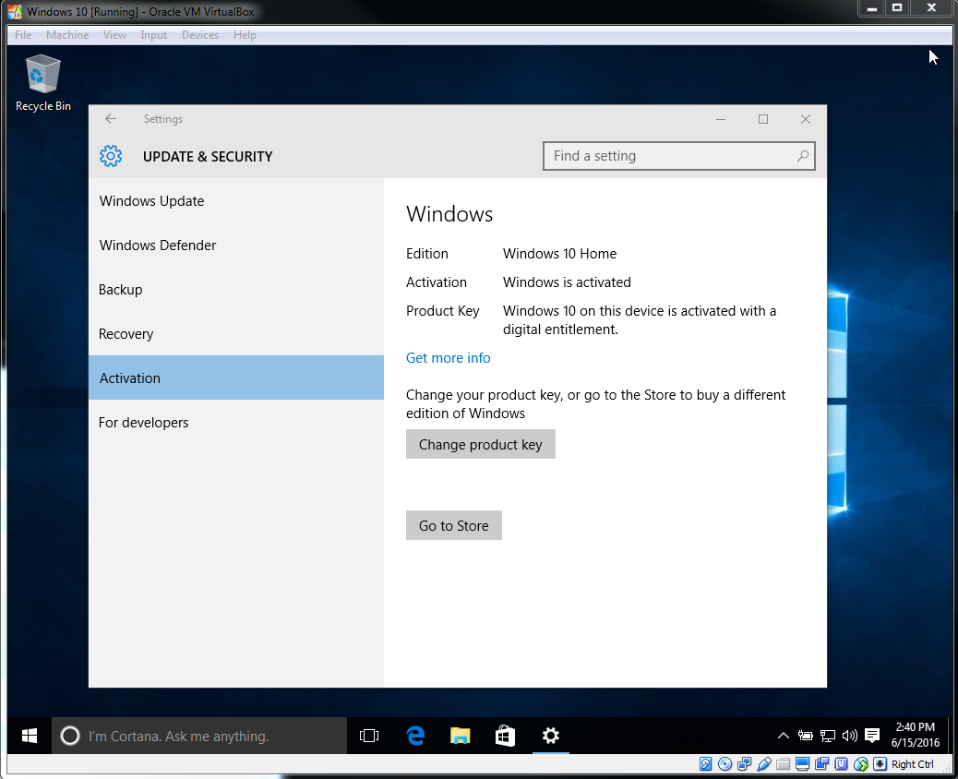
Windows 10 Activation
If your product key is not found in the BIOS, you must enter your own product key to license your software

Slide 14
Partitions and File Systems
A partition or a volume allows us to allocate space on a mass storage device to a file system.
At least one partition is required on each physical mass storage device.
without this partition we have nowhere to install a file system.

Slide 15
Partitions
Windows presents users and administrators with “Drives” that correspond to partitions.
Drives are assigned letters
Drive letters do not convey information about a partition’s location.

Slide 16
Partitions and File Systems
A file system allows us to manage information within a partition.
without a file system we have no way of managing the thousands of files and directories (folders) required by a productive computer system.
Multiple partitions are used to allocate space on a physical device to multiple file systems.

Slide 17
Virtual Memory
Virtual memory allows the operating system to access information faster.
Finding and formatting data from a file system for storage in RAM takes time.
Windows uses a page file to act as virtual memory for the system

Slide 18
Windows Supported File Systems
FAT32
FAT stands for File Allocation Table.
First shipped with Windows 95 OSR2
Is an updated version of the FAT16 file system that shipped with the original release of Windows 95
Supports drive sizes from 512 MB to 2 TB
Partition sizes are limited to 32 GB under newer versions of Windows

Slide 19
Windows Supported File Systems
NTFS
New Technology File System
Not supported by Windows 95 or 98
Uses a Master File Table (MFT) to track information about files on disk
Contains a transaction log so that recovery may be possible if disk problems occur

Slide 20
Windows Supported File Systems
NTFS
Offers compression and encryption services
Supports partitions as large as 256 TB
Offers comprehensive file and folder security

Slide 21
Windows ReFS File System
The newest file system from Microsoft is ReFS, or Resilient File System.
It is currently available in Windows Server, and is an option in Windows 8 and 10, but for now, requires a registry hack (going into the registry and changing settings) and/or special command line switches
ReFS is an improvement on NTFS, and is most often seen implemented in the server world

Slide 22
Disk Management
On your host machine, left-click the Start button and choose Disk Management
You can access this program directly from the Windows Command Prompt by executing: diskmgmt
You can also access the disk management utility by executing compmgmt from a command prompt and then choosing Disk Management from the left-hand panel

Slide 23
Disk Management
Disks have to be initialized before use.
The MBR partition style allows us to create and use up to four primary partitions or up to three primary partitions and an extended partition.
Windows will make the appropriate primary and extended partition choices for you.

Slide 24
Disk Management
FAT32 formatted partitions has deducted 4 MB from the total available space for its own use
100% of the remaining space is available to the end-user.
This does not mean that the FAT will not spill over into the user data area

Slide 25
Disk Management
NTFS formatted partitions present 100% of the allocated space to the end user.
Unlike the FAT formatted partitions, part of the space allocated to users is consumed by the MFT.
The amount of space required by the MFT means NTFS may not be the best choice for very small drives.

Slide 26
Files and Folders
Windows supports file names up to 255 characters.
A file or folder name can not contain any of the following characters: \ / : * ? " < > |

Slide 27
Files and Folders
File names are usually given a three character suffix to identify the file type. These include:
exe , bat , cab , msi , msc , dll
By default Windows does not display file types.
To display file types in Windows Explorer, choose View and click on ‘File Name Extensions’

Slide 28
Folder Structure
The root directory of a Windows file system is identified by a backslash \
Disk partitions and the file systems they contain are identified by their assigned drive letter
The root of a Windows 10 system volume (traditionally the C: drive) contains only four visible folders that we need to explore:
\Windows
\Users
\Program Files
\Program Files (x86)

Slide 29
Folder Structure
C:\Windows
Contains most of the files and folders required by Windows
.\System32 contains utilities and libraries
.\Temp provides a location for programs to store temporary files
C:\Users
Users home directories

Slide 30
Folder Structure
C:\Program Files
Install location for third party software
C:\Program Files (x86)
Install location for 32 bit third party software in a 64 bit environment.

Slide 31
Navigation
We may navigate Windows file systems using either Windows Explorer or the Windows Command Prompt
Note that if administrative privileges are required, right click the command prompt icon and select “Run as administrator”

Slide 32
Navigation
List folder contents using the command:
DIR [drive:][path][filename]
options include: /a list all files
/w wide listing
/? will provide a list of options (for any DOS command)
dir /a /w \
The Windows Command Prompt is not case sensitive.
Also note that the Windows directory separator is the back-slash ( \ )

Slide 33
Navigation
Paths can be stated in absolute or relative terms.
Absolute path starts at the drive letter
Relative path starts from where you are in the file system
For example, assume you execute the command
cd c:\Users ← this is an absolute path
then either dir \ (absolute) or dir ..\ (relative) will list the contents of the root directory of the C: drive

Slide 34
Navigation
dot dot (two consecutive dots) refers to the parent directory of the current directory.
.. or ..\
You can use dot dot notation to navigate back through a directory structure as required.
..\..\
references the parent directory of the current directory's parent directory.

Slide 35
Navigation
The cd (change directory) command is used to navigate the *nix directory structure.
cd [DIRECTORY]
No options are available for the cd command.
A path can be absolute or relative:
cd ABSOLUTE_PATH
or
cd RELATIVE_PATH

Slide 36
Wildcards
A wildcard is a special character that can stand for any other character, or, in some cases, a group of characters.
Wildcards are useful when working with several files whose names are similar or with a file whose exact name can’t be recalled.
Windows supports two wildcard characters * and ?
* matches zero or more characters
? matches exactly one character.

Slide 37
Navigation
The Windows Command Prompt supports the wild card characters. For example execute:
D:
will change to the root directory of D:
dir c:\windows\*.exe
will return all executable files in C:\Windows
dir c:\windows\w????.exe
will find all 5 character filenames starting with w and ending in .exe

Slide 38
Navigation
Change directories using the cd command
CD [/D] [drive:][path]
/D is known as a switch
this switch tells CD to change drives before navigating the specified path.

Slide 39
Navigation
You can also change file systems by simply entering the drive letter. For example:
cd \windows\fonts
D: <enter>
C: <enter>.
This will return us to our previous position on the C: drive

Slide 40
Working with folders
MKDIR [drive:]path
Creates a directory and any intermediate directories in the path, if needed.
e.g. mkdir e:\ntfs-testdir
RMDIR [/S] [/Q] [drive:]path
/s Removes all directories and files in the specified directory in addition to the directory itself.
/q Quiet mode, do not ask if ok to remove a directory tree with /S

Slide 41
Working with Files
COPY source destination
Copies one or more files to another location.
execute copy /? and review the output. What switch must you provide in order for copied files to be verified as correct.
DEL names
names specifies a list of one or more files or directories.
Wildcards may be used to delete multiple files. If a directory is specified, all files within the directory will be deleted.

Slide 42
Working with Files
To create an empty file, type:
copy NUL tf.txt
or (but, not truly empty)
echo. > tf2.txt

Slide 43
Working with Files
To view and/or edit a file, type:
Type filename (list only)
Notepad filename
Edit filename

Slide 44
FAT Attributes
FAT files are assigned attributes:
Read-Only
Hidden
System
Archive
File attributes can be viewed in the Windows GUI by right clicking a file, selecting properties, and viewing the details tab.

Slide 45
File Attributes
File attributes can also be viewed or changed at the Windows command prompt with the attrib command
ATTRIB [drive:][path][filename]
execute attrib /? at the prompt and take a moment to examine the output.
How would you add the hidden attribute to a file?

Slide 46
NTFS Attributes
NTFS supports the following attributes for files:
System
Read-only
Hidden
Archive
Compress
Encrypt
Index

Slide 47
NTFS Permissions
NTFS partitions allow you to specify access that each user has to specific files and folders.
Permissions are based on the user's logon name and group associations
An objects owner (files and folders are considered objects) or a user with appropriate rights can apply permissions to NTFS objects.

Slide 48
NTFS Permissions
If permissions are not explicitly granted they are implicitly denied.
Explicitly denied permissions override explicitly granted permissions

Slide 49
NTFS Permissions
NTFS security permissions for folders:
Full Control
Modify
Read & Execute
List Folder Contents
Read
Write

Slide 50
NTFS Permissions
NTFS security Permissions for files:
Full Control
Modify
Read & Execute
Read
Write
Working with NTFS permissions can be tricky.

Slide 51
File and Folder Properties
Create a new file at the cmd prompt
copy nul C:\ntfs-test.txt
Launch Windows Explorer from the cmd prompt
explorer C:\
Right click the ntfs-test.txt file and select Properties

Slide 52
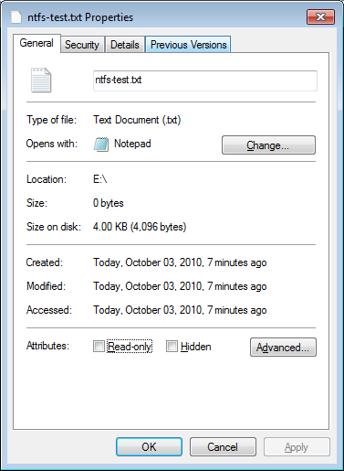
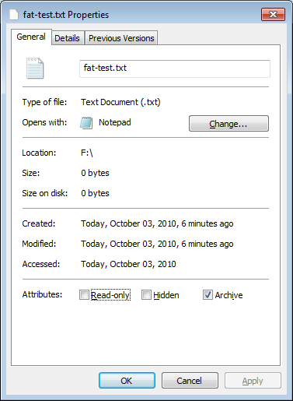
File and Folder Properties
Note the permissions tab on the properties dialog for ntfs-test.txt.
A permissions tab does not exist for file on FAT file systems because these are not available on FAT file systems.

Slide 53
NTFS Data Compression
NTFS has the ability to compress or decompress data under certain conditions.
Files and folders are managed independently, which means:
uncompressed files can reside in a compressed folder.
compressed files can reside in an uncompressed folder.
Compression can be managed through Windows explorer or through the compact cmd line utility

Slide 54
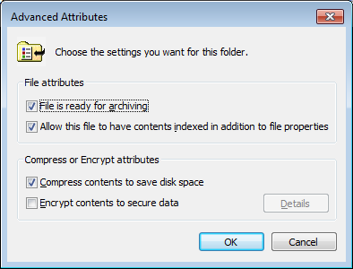
NTFS Data Compression
Using Windows Explorer, compression can be enabled or disabled using an object's properties dialog. Under the General tab, click Advanced
The following dialog will appear:
Select or deselect the compression attribute. Click OK to apply changes.

Slide 55
Compressed Folders
Compressed folders, which are another form of data compression, can be created using almost any combination of files and folders.
Practice this by:
selecting ntfs-testdir and ntfs-test.txt
right clicking one of the files, select Send to > Compressed (zipped) folder
You will get an error because the directory is empty. Clicking OK will create the archive without this directory.
How do you extract the archived files?

Slide 56
Homework
Recommended Activity:
Add two virtual hard disks to your VirtualBox Windows Installation
2 * 100 MB
Initialize these disks using MBR
install a FAT32 file system on one and NTFS on the other.
Examine the disks using the disk management utility
Explore file system attributes of FAT32 and NTFS file systems.
Install whois for Windows command line on your Windows Virtual Box

